Slide 1
Significant Paper Report
By Group 1:
Alan Boo
Aayush Dixit
Che Liu
Gideon
Yanyan Yang

Slide 2
Background
Related topic “ A Machine Learning Approach to College Drinking Prediction and Risk Factor Identification” that found in the Google Scholar
Paper Main purpose
Improve generalizability for longitudinal datasets
Help secondary analysis of alcohol misuse
Provide insights for alcohol intervention programs
Proposed methods
Temporally-correlated support vector machine
Combination of cluster analysis

Slide 3
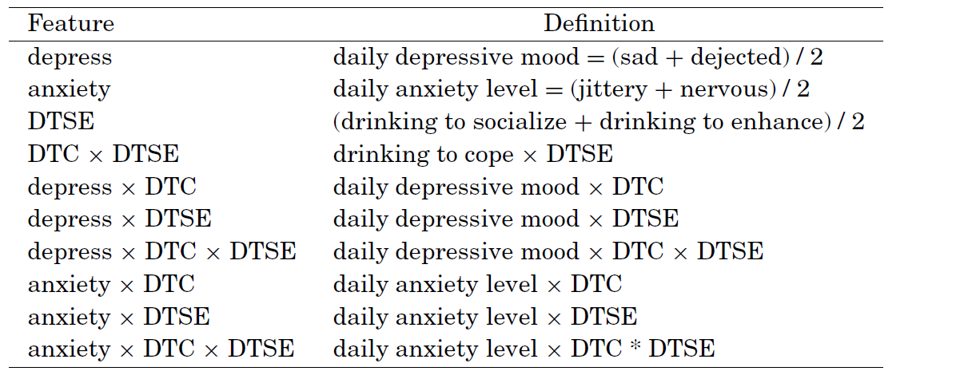
Background
Longitudinal Dataset
1 year survey about college drinking
15120 records, 10 features

Slide 4
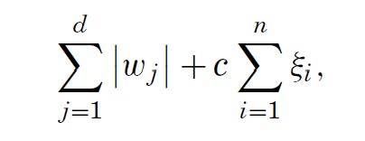
Temporally-Correlated SVM
Goal:Longitudinal analysis to identify daily risk factors for binge drinking
1-norm SVM based on linear function w^{T}x+b
w: weight vector to be determined
x: input vector: one daily record
Minimizing regularized risk function:
d: number of total variables/factors
n: number of records reported in training set

Slide 5
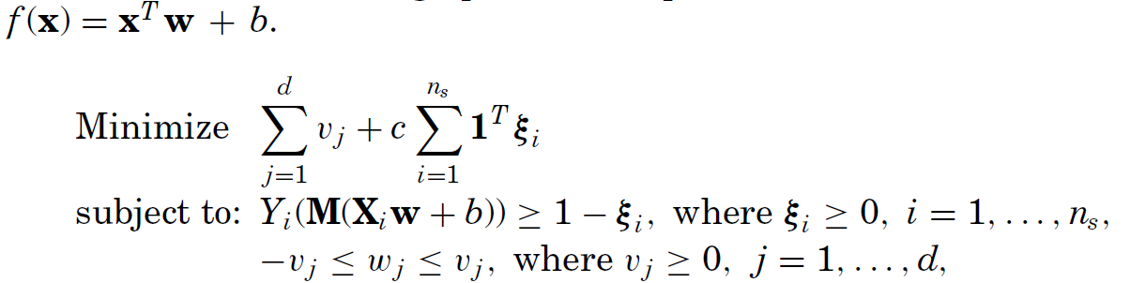
Temporally-Correlated SVM
Turns previous functions into following optimization problem:

Slide 6
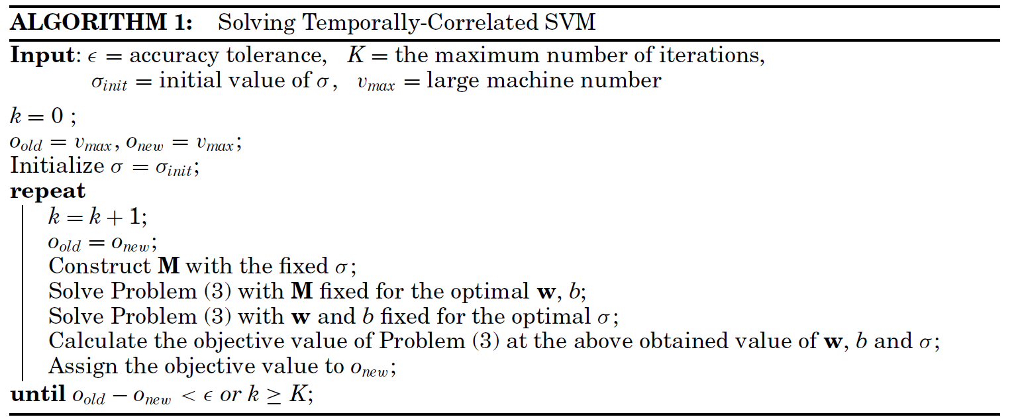
Temporally-Correlated SVM

Slide 7
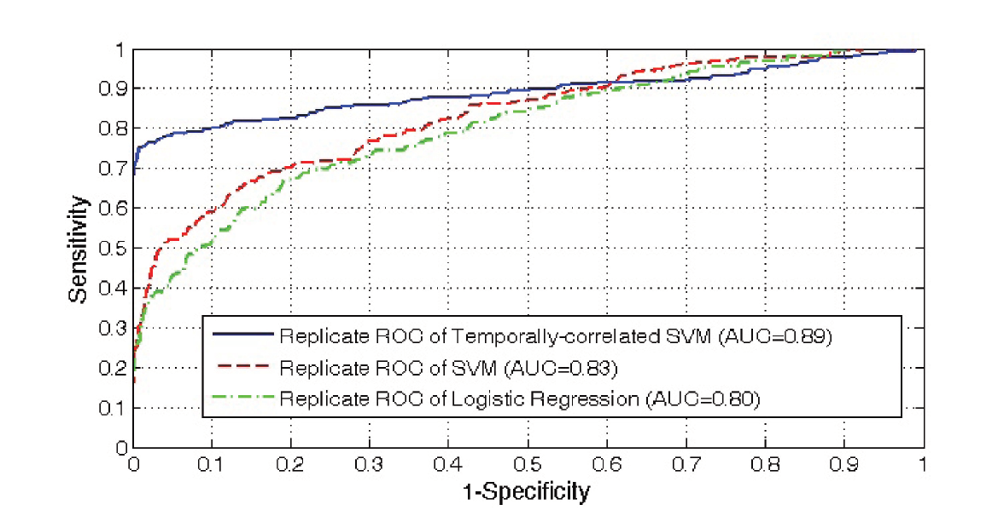
ROC Curve Comparison

Slide 8
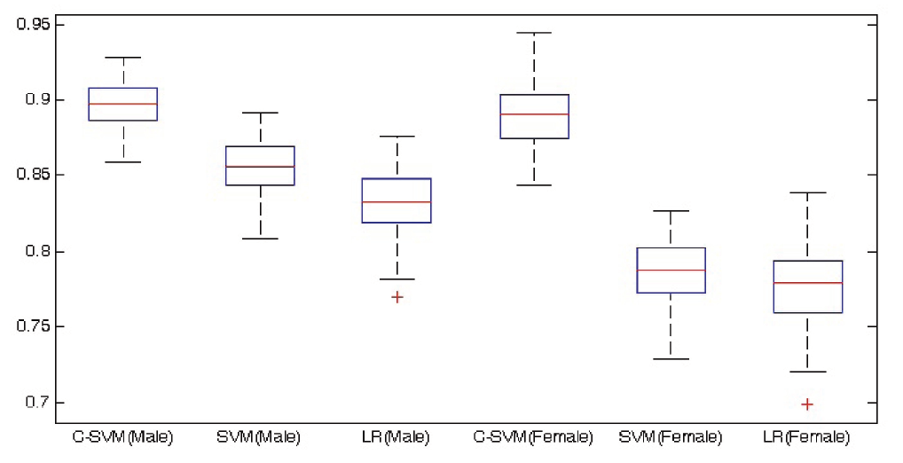
AUC Comparison

Slide 9
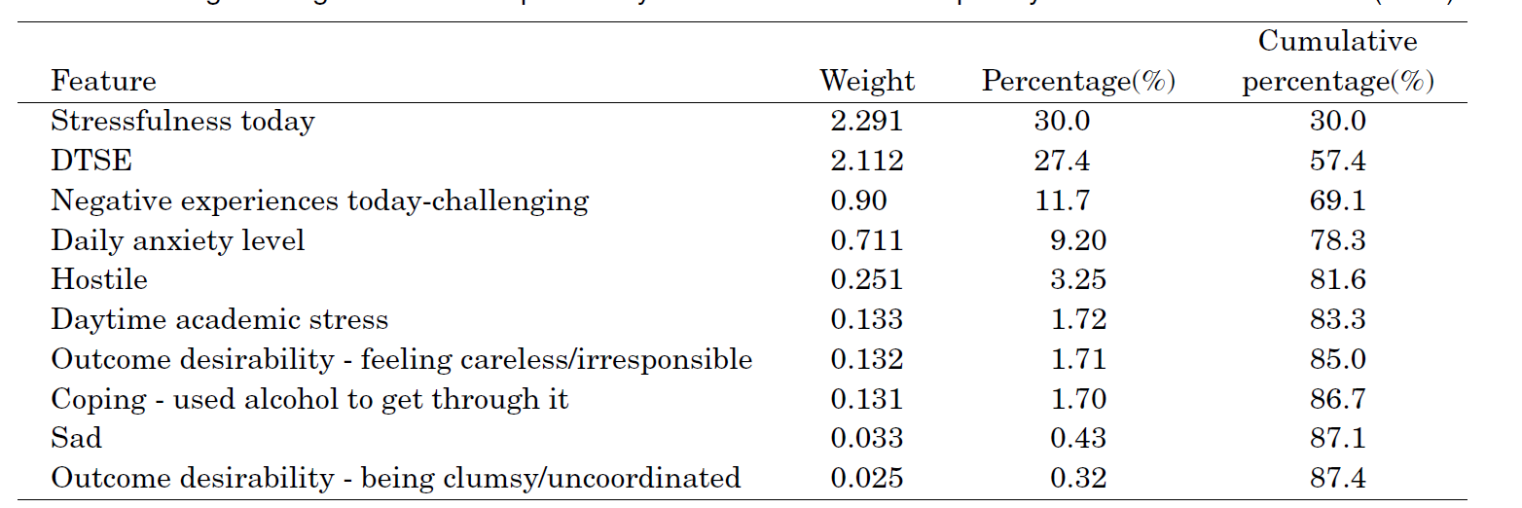
C-SVM Result for Male

Slide 10
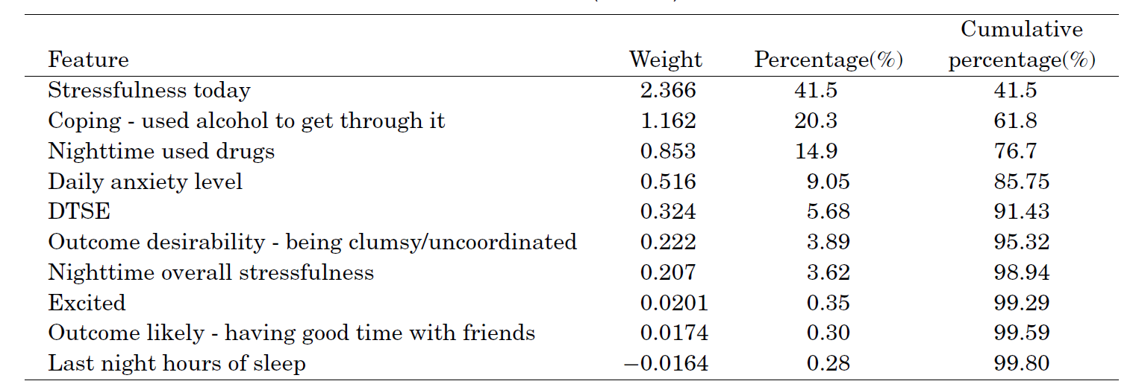
C-SVM Result for Female

Slide 11
Composite Learning Scheme
Goal: identify person-level risk factors for binge drinking
Multiple correspondence analysis(MCA) to compacts categorical variables into lower-dimensional space
Standard normalization for each risk factor
K-Medoids clustering algorithm
Group 4 objects(DrinkFreq, DrinkAmnt, DrunkFreq, AlcDep) into 3 clusters
1: non-risk drinker group
2: moderate drinker group
3: heavy drinker group

Slide 12
Composite Learning Scheme
Built 3 Classifiers
Partition each group
By gender
Split into 2/3 training set, 1/3 test set
Advantage
Allows independent test for each classifier
Ratio in each group remain same as the ratio for the entire data

Slide 13
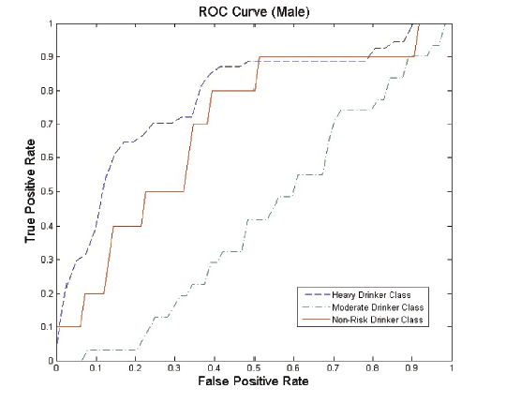
ROC Curve for Male
Heavy drinking classifier had moderate accurate
Non-Risk drinking classifier had moderate accurate
Moderate drinker classifier performs poorly

Slide 14
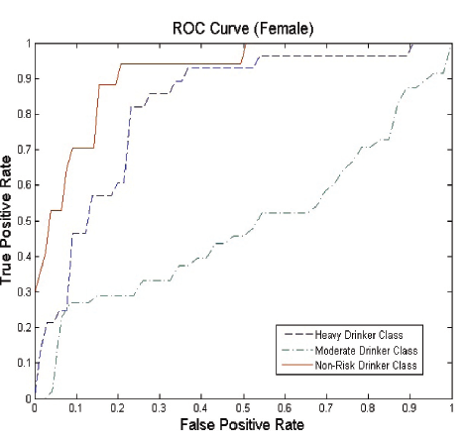
ROC Curve for Female
Non-Risk drinking classifier had highest accuracy
Heavy drinking classifier had high accuracy
Moderate drinker classifier performs poorly

Slide 15
Thank you!

